Slide 1
Mobile and Embedded Computing
Lecture 4. Debugging & Tools, State management techniques intro, Equatable

Slide 2
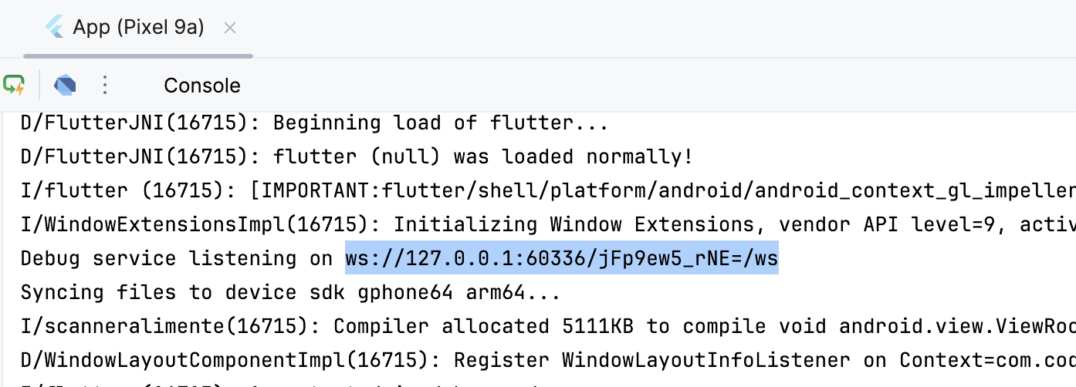
Flutter Dev Tools
Usually on http://127.0.0.1:9100/home
You will need this URL that is printed in the console:

Slide 3
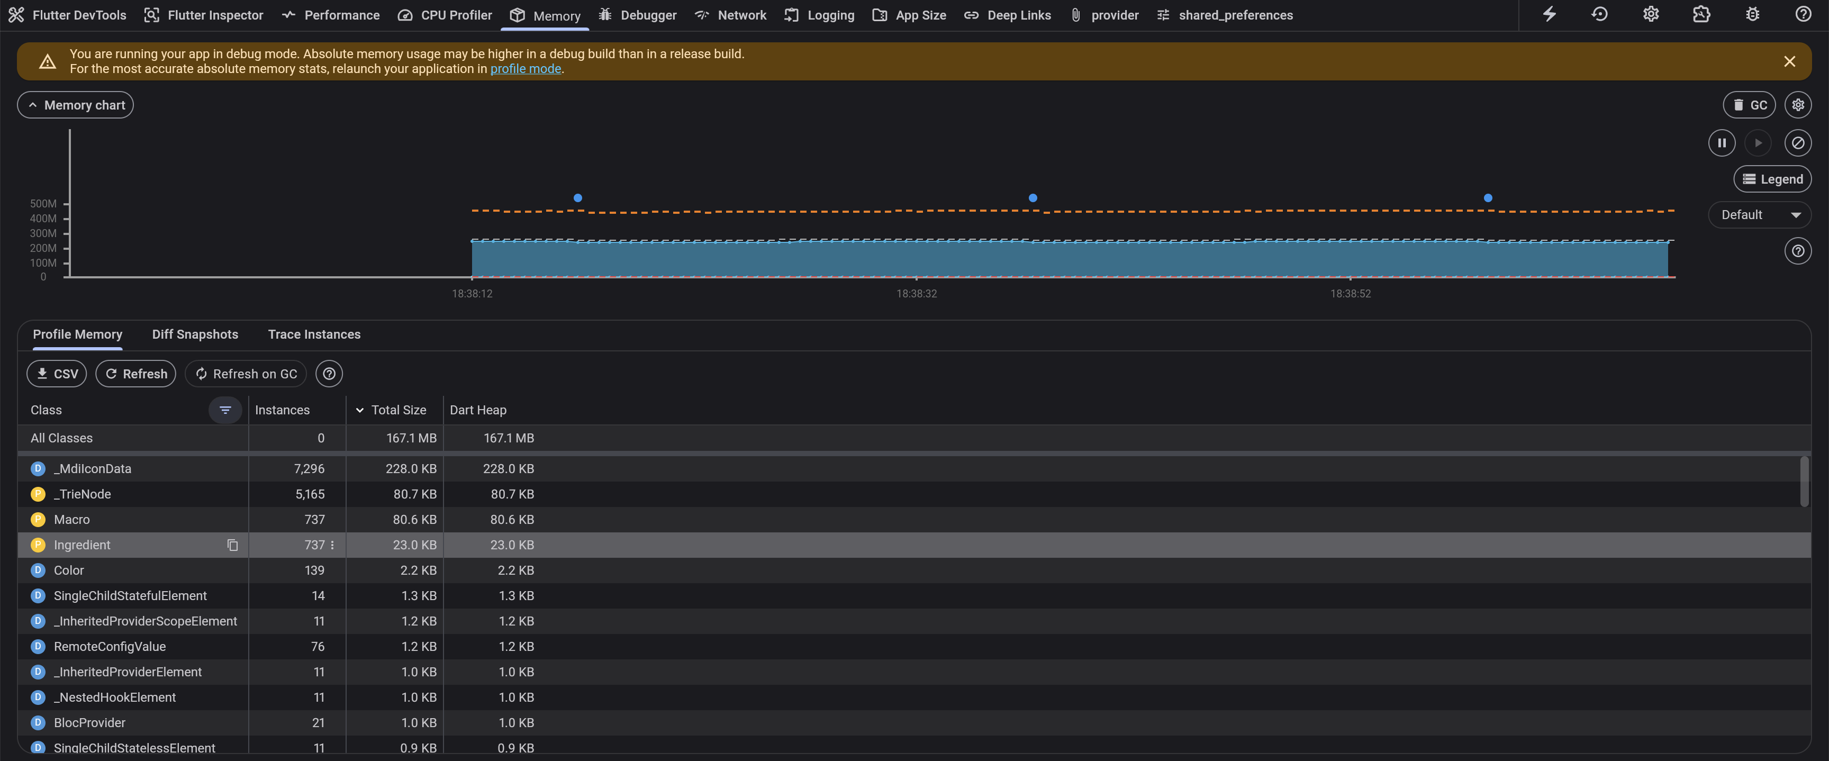
Flutter Dev Tools

Slide 4
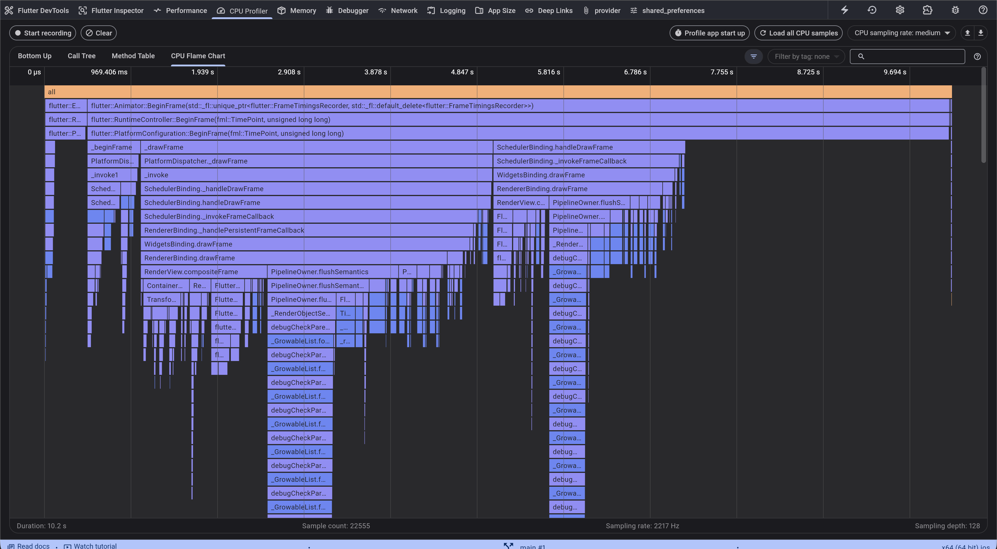
Flutter Dev Tools

Slide 5
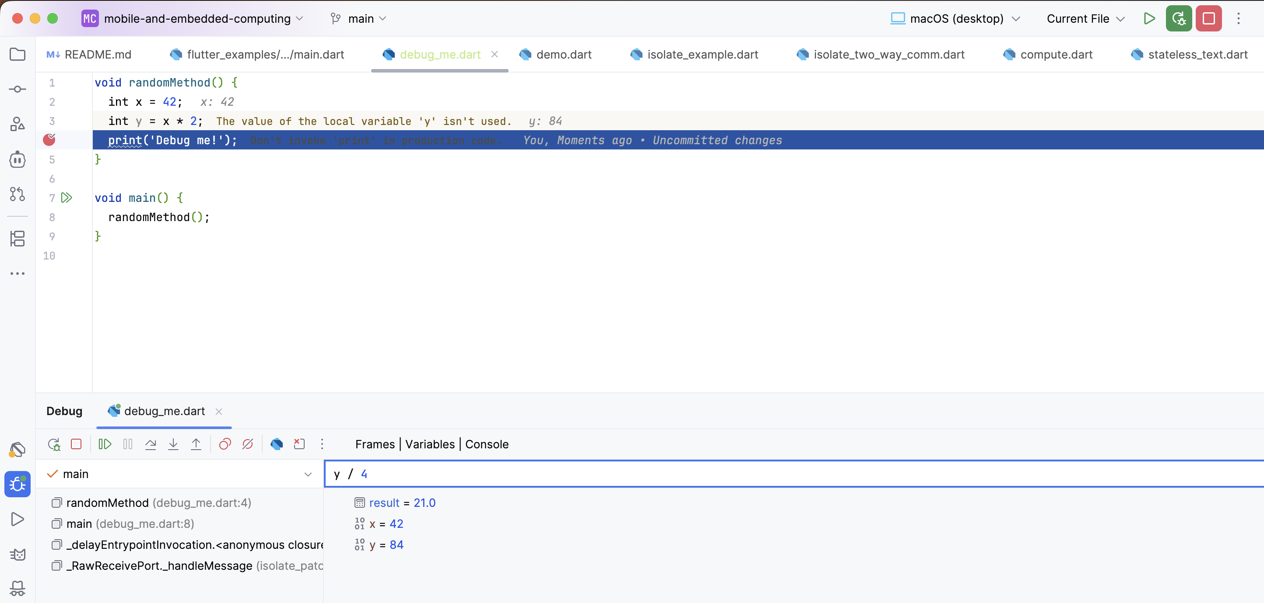
Using a debugger

Slide 6
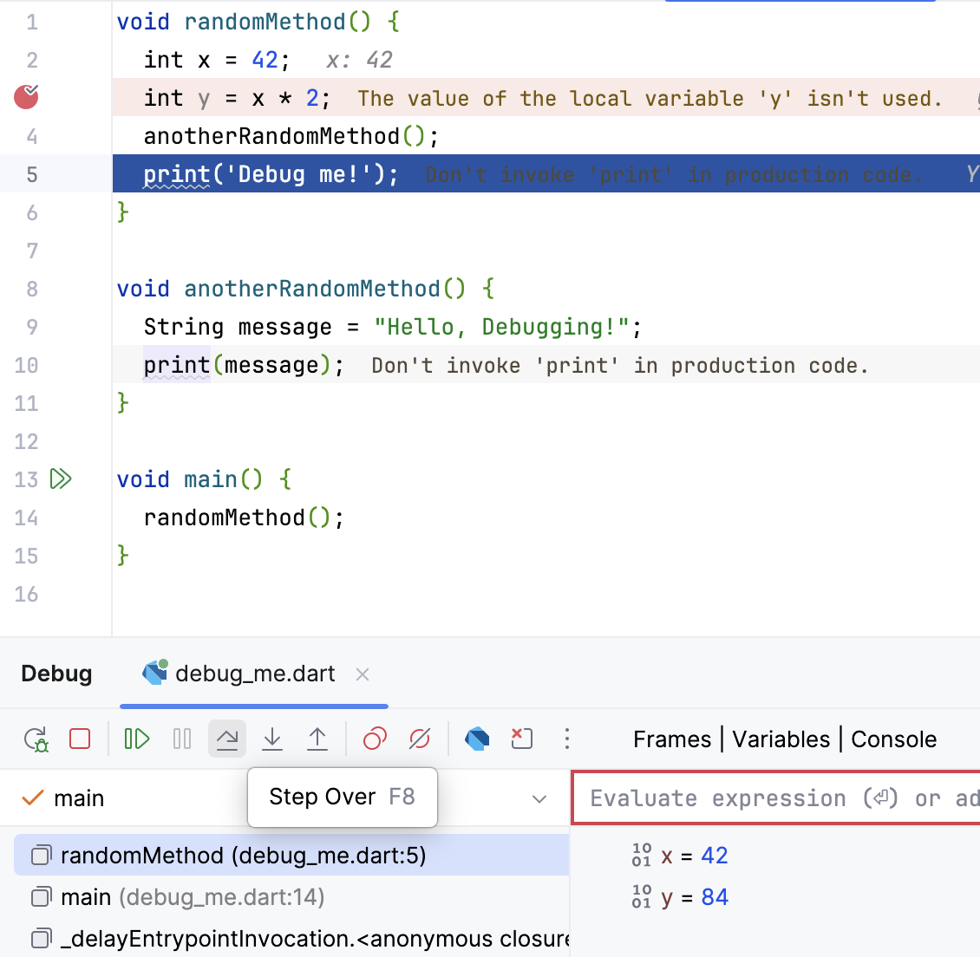
Step Over – Moves line by line without entering in any method

Slide 7
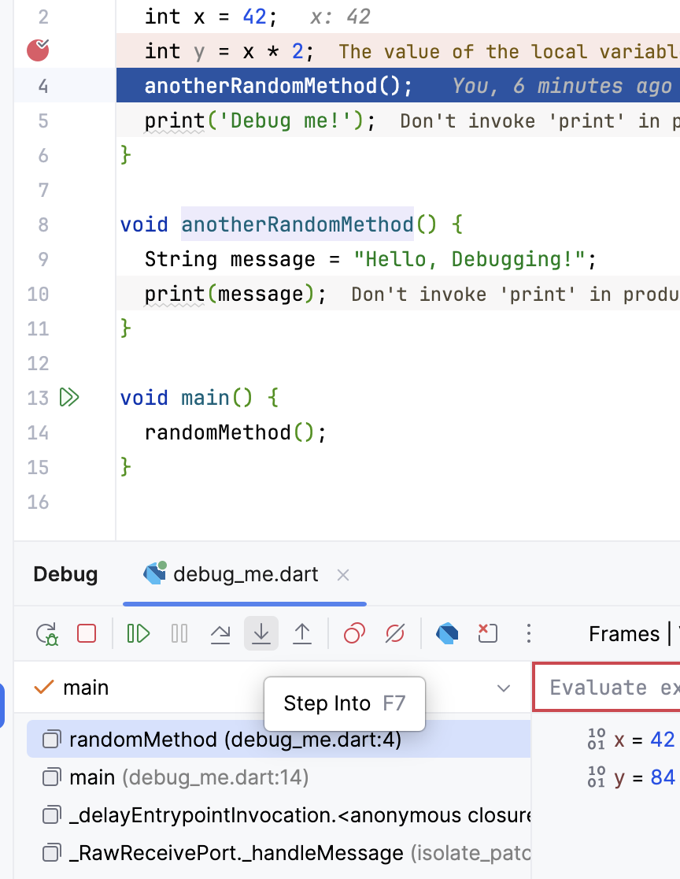
Step Into – If applied on a method, the debugger will move into that method

Slide 8
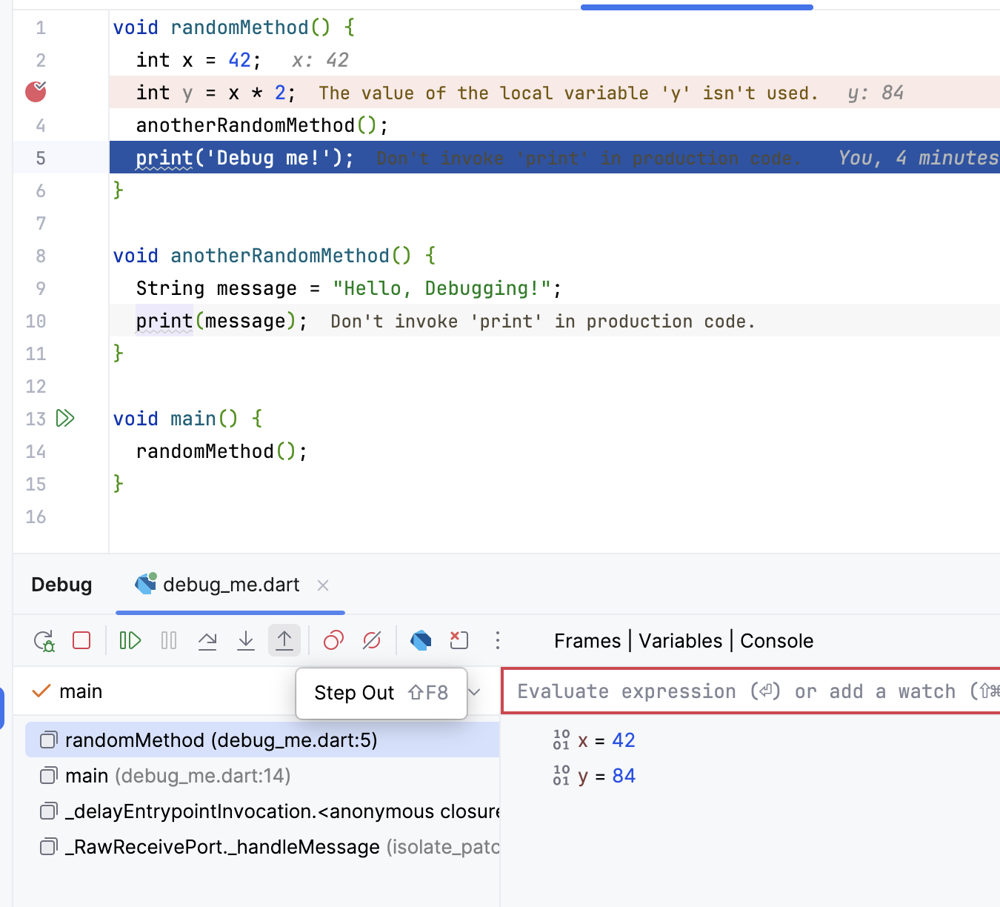
Step Out – Goes out of a method back to the previous one

Slide 9
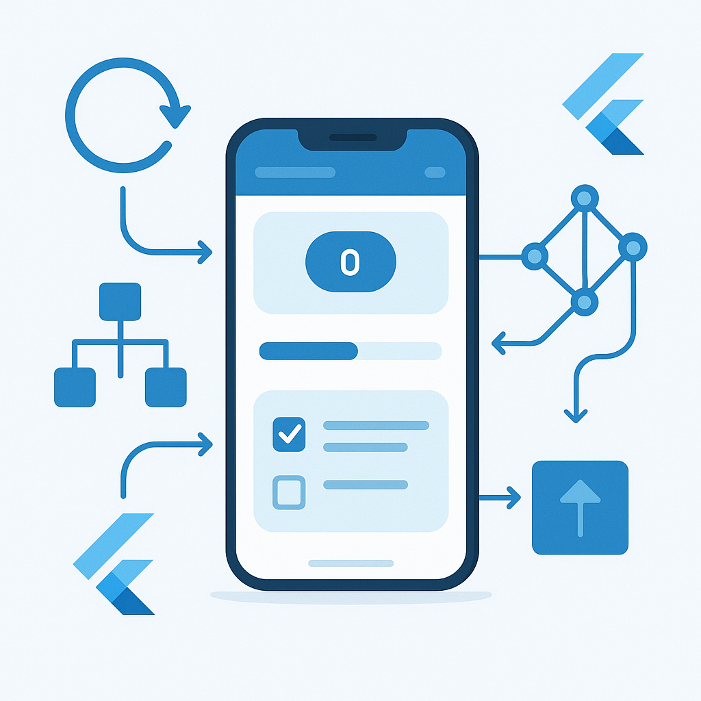
State management techniques

Slide 10
Introduction to State
State is the data that changes over time in your app.
Whenever that data changes, your UI must update to reflect it.
Example:
The number on a counter app.
The text in a form field.
Whether a user is logged in or not.
In Flutter, widgets themselves are immutable once created, they can’t change.
So when the state changes, Flutter rebuilds widgets with the new data.

Slide 11
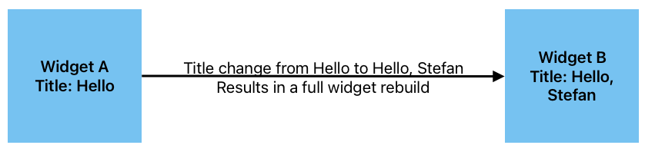
What is Immutability?
“Immutable” means unchangeable, once an object is created, it cannot be modified.
Instead of changing the object, Flutter creates a new instance when something changes.

Slide 12
Why are widgets immutable?
Predictability: UI doesn’t mutate unexpectedly.
Performance: Flutter can efficiently rebuild only what changes.
Simplicity: No complex change tracking; just rebuild.
Debugging ease: Each UI frame is a pure function of its state.

Slide 13
Widget Lifecycle and Rebuilds
Flutter builds a Widget Tree each frame.
If data changes:
Flutter compares old and new widgets (using keys).
Keeps elements that didn’t change.
Rebuilds parts that did.

Slide 14
Type | Description | Example Use
StatelessWidget | Immutable, builds once. | Labels, Icons
StatefulWidget | Has internal state; triggers rebuilds. | Forms, Buttons

Slide 15
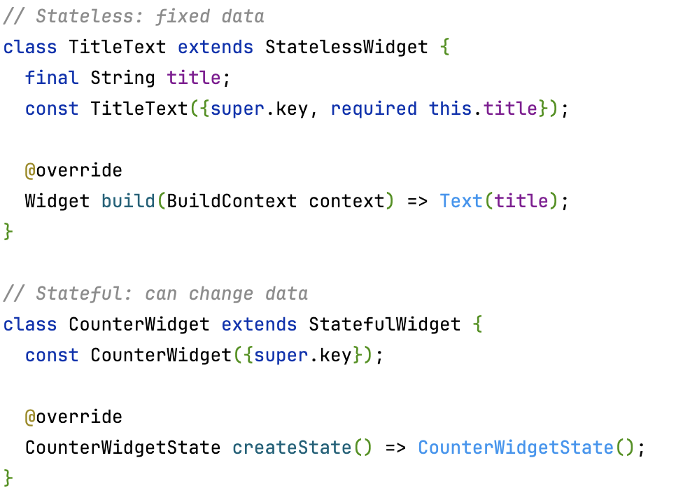
Widgets are blueprints for UI elements, not the actual UI on screen.
When you “change” something, Flutter just uses a new blueprint to draw the updated UI.

Slide 16
Types of state
Type | Description | Example
Ephemeral (Local) State | State that lives in a single widget. | Toggle switch, counter, checkbox.
App (Global) State | Shared across multiple widgets or screens. | Logged-in user, theme mode, shopping cart.

Slide 17
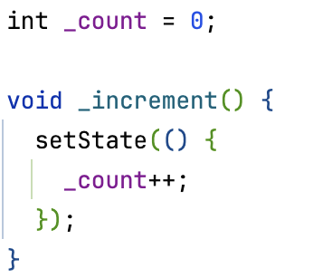
setState() – The Basics
The setState() method is the most basic way to manage state in Flutter.
It’s used inside a StatefulWidget to update local state.
Logic and UI get mixed together.
Hard to reuse state in other widgets.
Doesn’t scale for complex apps.

Slide 18
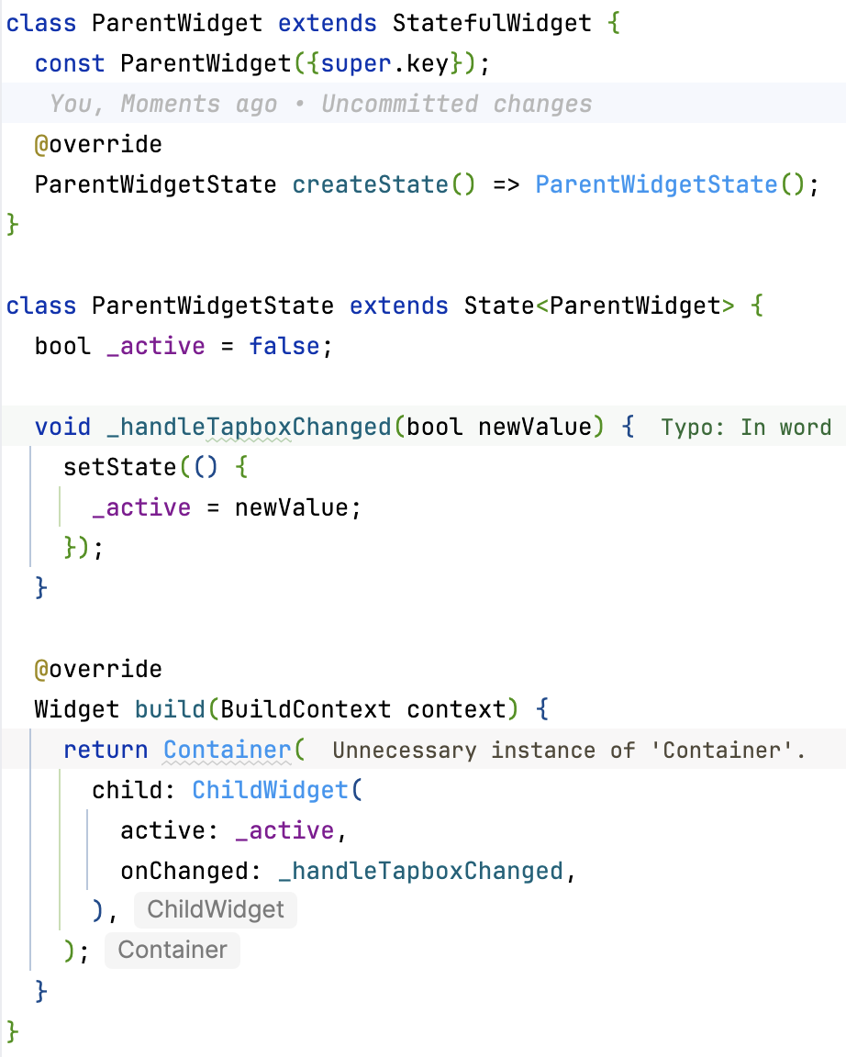
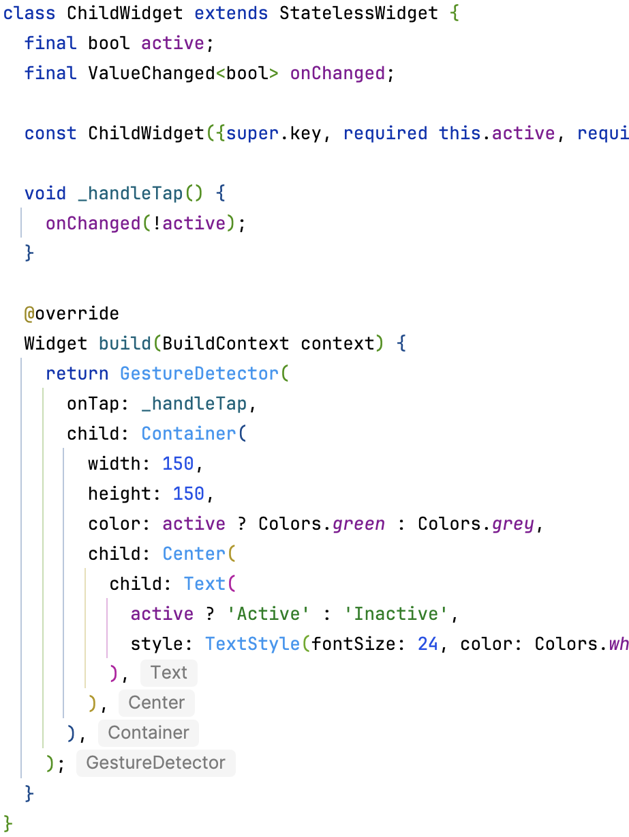
Lifting State Up
When two widgets need to share the same data, you can lift state up to their common parent.
Keeps widgets reusable and independent.
Promotes clear data flow: Parent → Child (data) and Child → Parent (events).
If you lift state up too far, it becomes hard to manage. Passing data through many layers (“prop drilling”).

Slide 19
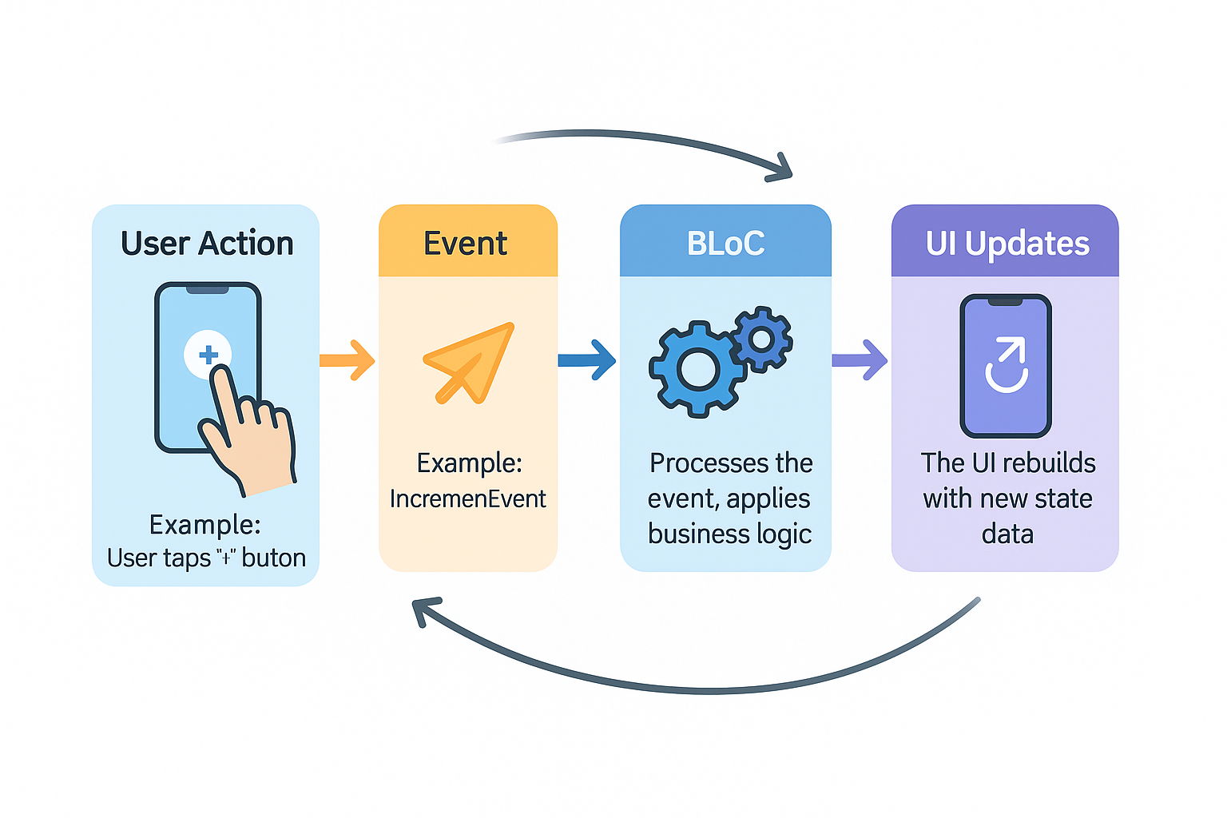
BLoC (& Cubit pattern)
Separates UI from business logic with a stream-based approach
BLoC: Uses events and states via Stream and Sink.
Cubit: A simplified BLoC that emits states directly.

Slide 20
BLoC
BLoC stands for Business Logic Component.
It separates UI from business logic, making code modular, reusable, and testable.
UI Layer: Displays data (states).
BLoC Layer: Contains logic and transforms events → new states.
Data Layer: Handles API calls, databases, etc.

Slide 21
Cubit
Cubit is a simpler version of BLoC.
Cubit: Emits new states directly (no separate events).
BLoC: Works with events and states, offering more structure.

Slide 22
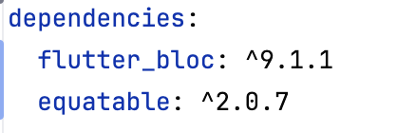
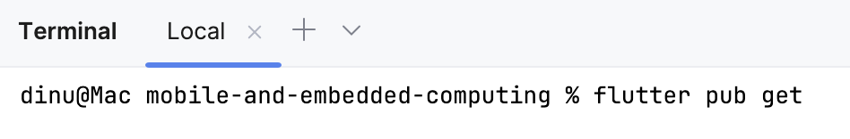
Bloc & Cubit Required dependencies
You can add new dependencies in pubspec.yaml
Then you will need to run flutter pub get to fetch them
Upgrading dependencies is done using flutter pub upgrade

Slide 23
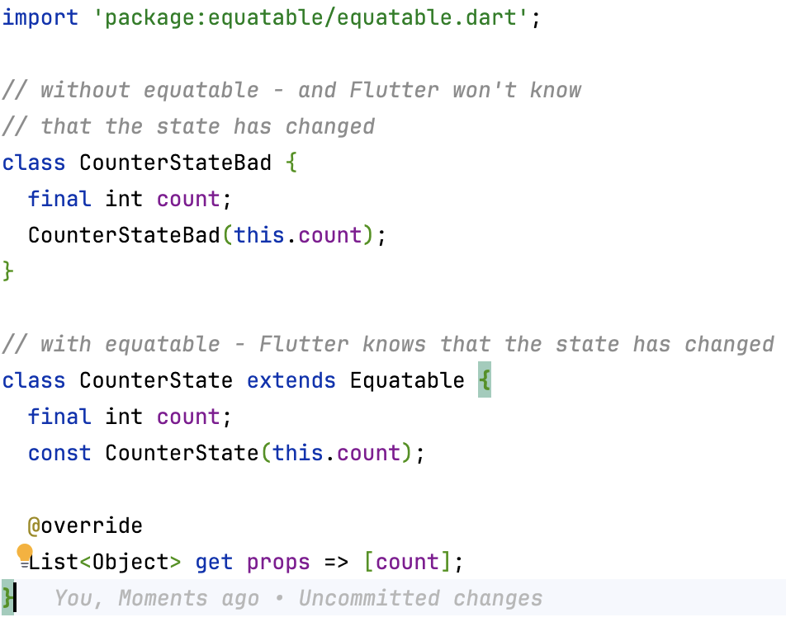
Equatable
In Flutter BLoC, the UI only rebuilds when the state changes. But how does Flutter know if the new state is different from the previous one?
Without Equatable, Dart’s default equality check compares object references, not values. So even if two CounterState(1) objects have the same count, Flutter thinks they’re different, causing unnecessary rebuilds. Equatable fixes this by comparing objects by value.

Slide 24
Best Practices and Recommendations
Keep UI (widgets) and logic separate.
Use immutable data models when possible.
Dispose streams and controllers properly.
Start simple (setState → Riverpod/BLoC).
Pick what fits your project.

